Slide 1

Programmatic data access and retrieval
The API of the GWAS Catalog
Daniel Suveges
Bioinformatician
www.ebi.ac.uk/gwas
Notes:
Today I’m going to give you an introduction to the GWAS Catalog. It’s fairly straightforward to use, but what I’m really going to be focusing on is giving you an understanding of the data structure, where it comes from and what you can do with it.

Slide 2
API Workshop
Presentation
What is an API, why should I use it?
How to extract data via API
Understanding the returned data
GWAS Catalog API
GWAS Catalog Summary statistics API
Interactive session
Notes:
Starting with a presentation where we talk about what an API is, and when to use it?
How to extract data via an API
How to understand the returned data
GWAS Catalog API - access to the manually curated dataset via API
GWAS Catalog Summary stats API - access to the summary stats database.
The presentation is followed by a short interactive session to try the API in practice

Slide 3


High-throughput access
Web interface: optimal for low-throughput, exploratory data access.
How to check 100s or 1000s of variants?
Notes:
The user interface allows low-throughput data access mostly useful for exploratory data access.
When the number of queries high, it could be overwhelming to check all the individual pages.
Eg. after a GWAS Study, the bioinformatician has 1000 potential associations to replicate. How to prioritize? Checking all of them?
Pipelines that required to automatically retrieve data from various sources.
API: interface to allow applications to communicate
(Users who are interested in the entirety of the catalog, they can download and parse the flatfiles)

Slide 4
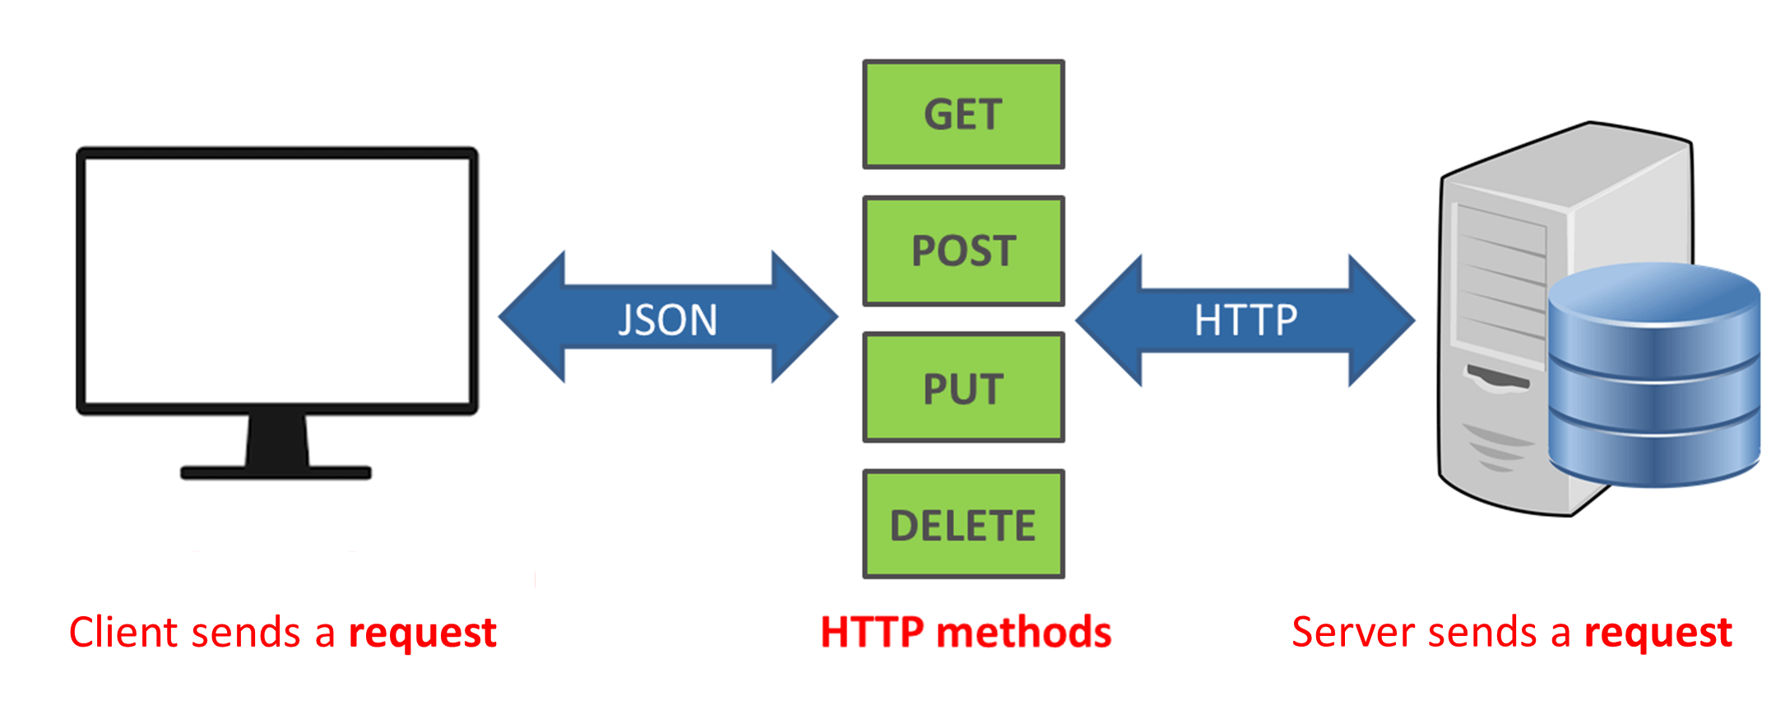
What is an API?
Interface between application instead of users
Client: script, other application or user
Requests are formulated as URLs
Standardized, machine readable responses

Slide 5
Extracting data
Requests are URLs:
Further arguments:
https://www.ebi.ac.uk/gwas/rest/api/studies
API address endpoint
…/api/studies
…/api/studies/GCST000854
…/api/studies/GCST000854/associations
…/api/studies/search/findByPublicationIdPubmedId?pubmedId=21041247
Notes:
The request is formulated as a URL (what you can type in your browser’s address bar)
Then request is sent back to the server that prepares the requested data and send back.
Why this setup useful? Any programming language or even a browser can be used to fetch data from the server. (It doesn’t matter if you are using bash, Perl, R, Java or Python. Anything will do the job)
The endpoints usually can take further arguments to make the response more specific

Slide 6
Understanding the returned data
The returned data is formatted in standardized, machine readable format (JSON):
Extract required field eg. study accession.
User has to be aware of the design of the returned data.
Documentation of the GWAS Catalog API:
https://www.ebi.ac.uk/gwas/rest/docs/api
Key-value pairs: | Lists:
{ "key1": "value1", "key2": "value2" } | [ "value1", "value2" ]
Notes:
It is essential that user investigate the documentation of the API to learn about the available endpoints and ways to access specific type of data
Extracting data using suitable packages

Slide 7
The GWAS Catalog REST API
API address: https://www.ebi.ac.uk/gwas/rest/api/
Endpoints:
…/api/studies/GCST000028/associations
…/api/singleNucleotidePolymorphisms/rs224073/studies
…/api/efoTraits/EFO_0001360
…/api/associations
Search by...
…/api/endpoint/search
Search study by pubmed ID etc.
Search variant by gene, genomic region etc.
Search association by pubmed ID etc.
Notes:
Similarly structured API exists for summary statistics hosted by the GWAS Catalog
Not covered in this presentation, but links are provided.

Slide 8
Further reading
Workshop material online:
https://github.com/EBISPOT/GWAS_Catalog-workshop/
Documentation on the APIs:
GWAS Catalog: https://www.ebi.ac.uk/gwas/rest/docs/api
Summary statistics: https://www.ebi.ac.uk/gwas/summary-statistics/docs/

Slide 9
Interactive session
Python and interactive Jupyter notebooks
Exercises:
Query the REST API using a browser
Programmatical access of the same data
Retrieve a data for multiple entries
Pooling data together from different endpoints (optional)

